Slide 1
Software Engineering CS 487
Dennis Hood
Computer Science
Fall ‘19
Notes:
This template can be used as a starter file for presenting training materials in a group setting.
Sections
Right-click on a slide to add sections. Sections can help to organize your slides or facilitate collaboration between multiple authors.
Notes
Use the Notes section for delivery notes or to provide additional details for the audience. View these notes in Presentation View during your presentation.
Keep in mind the font size (important for accessibility, visibility, videotaping, and online production)
Coordinated colors
Pay particular attention to the graphs, charts, and text boxes.
Consider that attendees will print in black and white or grayscale. Run a test print to make sure your colors work when printed in pure black and white and grayscale.
Graphics, tables, and graphs
Keep it simple: If possible, use consistent, non-distracting styles and colors.
Label all graphs and tables.

Slide 2
Homework #4
Design a Facilities Management Robot
The robot roams the campus maintaining buildings
It also communicates with control systems in each building to check status and respond to facility requests
It also communicates with public safety, fire, police, and weather service providers to request notifications of “trouble”
Deliverable
Draw a context model / system diagram (1 pt)
Develop binary signaling protocols (commands using only 0’s and 1’s) between the robot and all system elements (2 pts)
Write pseudo-code for the robot (2 pts)
Receiving and responding to requests
Binding to service providers to request information
Checking building status and conducting normal maintenance
Participation for Online Students (2 pages max)
Discuss the service-level agreements which would be needed to support reliable performance of the robot
Discuss the role of “priorities” in the robot’s decision making
Please submit by 11/16/19

Slide 3
Lesson Overview
Service-Oriented Architecture
Reading
Ch. 18 – Service-oriented Software Engineering
Objectives
Systems are collections of cooperating sub-systems
As discussed previously in several contexts, the overall success of a system is dependent in large part on the predictable and reliable interaction with the various sub-systems
Service-oriented architectures extend to include sub-systems to which the “main” system binds at runtime

Slide 4

Week 12
Service-Oriented Architecture
Notes:
This is another option for an Overview slides using transitions.

Slide 5
Service-Oriented Architecture (SOA)
Based on the notion of cooperating entities
Entities offer to perform services
Information can be made available in a controlled and managed way
Defined interfaces must be published
Allows for the creation of configurable, distributed, platform-independent systems

Slide 6
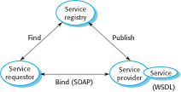
Service-Oriented Architecture

Slide 7
Web Services
A web service is an instance of a more general notion of a service:
“an act or performance offered by one party to another. Although the process may be tied to a physical product, their performance is essentially intangible and does not normally result in ownership of any of the factors of production.”
The provision of the service is independent of the application using the service
Service providers can develop specialized services and offer these to a range of service users from different organizations

Slide 8
SOA-related Standards
SOAP – SOA Protocol
Message interchange
Supports communication between services
WSDL – Web Services Definition Language
Service interface definition
Establishes definition for service operations and bindings
WS-BPEL – Web Services Business Process Execution Language
Workflow language

Slide 9
Benefits of SOA
Services can be provided locally or outsourced to external providers
Services are language-independent
Investment in legacy systems can be preserved
Inter-organizational computing is facilitated through simplified information exchange
Reuse

Slide 10
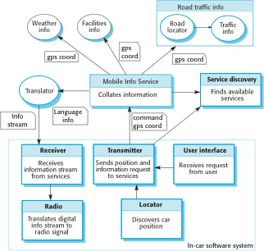
Ex.: Car Information System

Slide 11
Ex.: Car Info Systems (cont.)
It is not necessary to decide when the system is programmed or deployed what service provider should be used or what specific services should be accessed
As the car moves around, the in-car software uses the service discovery service to find the most appropriate information service and binds to that
Because of the use of a translation service, it can move across borders and therefore make local information available to people who don’t speak the local language

Slide 12
Reusable Services
Once established, a service can be used by any number of “systems”
Well-defined interface
Consistent, reliable performance
Independent and loosely coupled
WSDL specification
What – the interface description
How – details of how to communicate
Where – the location of the implementation

Slide 13
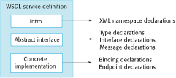
WSDL Specification

Slide 14
Service Types
Utility services
General functionality
e.g., currency conversion
Business services
Associated with a specific business function
e.g., student registration
Coordination of process services
Support more general business processes
e.g., procurement process management

Slide 15
Service Engineering
The process of developing services for reuse in service-oriented applications
The service has to be designed as a reusable abstraction that can be used in different systems
Generally useful functionality associated with that abstraction must be designed and the service must be robust and reliable
The service must be documented so that it can be discovered and understood by potential users

Slide 16
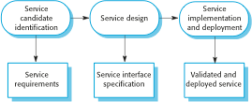
Service Engineering

Slide 17
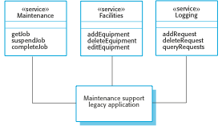
Legacy System Wrappers
Extend the life of legacy systems
Provide an interface in the form of a wrapper instead of rewriting (or “sun-setting”)

Slide 18
Service Testing Considerations
Control or even access to external services is determined by the service provider
An application may not always use the same service each time it is executed
Performance may differ under varying loads – loads which can vary greatly depending on the number and frequency of service requests
Testing of exception handling may depend on proper failure of dependent services

